Slide 1
Twenty Ninth Division
Second Phase of Meuse-Argonne OCT 1918
Advance of the 116th Infantry Regiment
by
CW4 Ralph Lovett
29 ID Field Artillery Intelligence Officer

Slide 2
World War 1 Overview
AUG 1914 A Slavic terrorist organization named the Black Hand with support from Serbia assassinates the Austro-Hungarian (KuK) archduke and his wife. This event sparks conflict between rival European powers
1914 Much of Europe and other nations worldwide fall into service with one of the two rival groups due to preexisting treaties, long simmering nationalistic disputes, and economic competition. The two rival groups are known as the Allies and the Central Powers
1914-16 Initial gains by the Central Powers against France are stalled by a combination of defensive works (trenches) and, troop strength, and firepower
MAY 1915 Sinking of the Lusitania, with US civilian casualties, pushes US public sentiment against the Central Powers
1916 The United States is raided by Mexican militia in 1916 killing American civilians. The US Army is mobilized, including much of its National Guard for the Punitive Expedition against the Mexican militant groups. Most National Guard units stay federalized even after the crisis
JAN 1917 The Zimmermann Telegram implicates Germany in a plot to encourage additional Mexican aggression against the USA
FEB 1917 Russia Falls (The ally of France and Britain)
APR 1917 US Declaration of War against the Central Powers (Austro-Hungary, Germany, Ottoman Empire, and Bulgaria)
JUL 1917 29th Division founded
OCT 1917 First US troops reach Europe
JUL 1917 The 29th Division reaches Europe
JUL 1918 The 29th Division enters the combat area
OCT 1918 The 29th Division committed in the Meuse-Argonne Offensive (29th takes approximately 5000 casualties)
11 NOV 1918 The Armistice ends the fighting

Slide 3
Meuse-Argonne Overview
By 1918 the German and Austro-Hungarian armies are heavily attrited
Simultaneous Allied assaults all along the Western Front put great pressure on the German defensive positions (The Hindenburg Line/Siegfriedstellung)
The Allied objective of the Meuse-Argonne Offensive is to capture the German rail hub in Sedan, France in order to disrupt logistic support of the German Armies in Belgium and France
Phase One-A combined advance by the American and French Fourth Army on both sides of the Argonne Forest, to link up at Grandpre’
Phase Two-A further advance to the line Le Chesne to outflank the German position behind the Aisne River and clear the way for the American-French advance on Sedan
Phase Three-Capture the Heights of the Meuse
You can think of the American-French advance as looking like a door swinging from left to right, hinged on Verdun (see the next map)

Slide 5
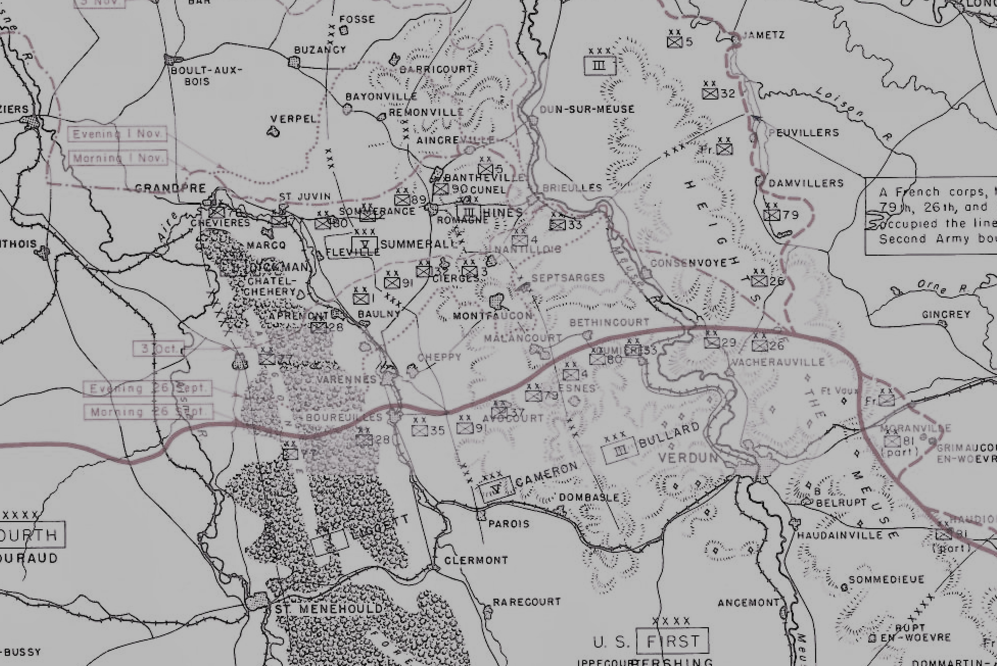

Slide 6
Opposing Forces Overview 29th Division verses the Austro-Hungarian (KuK) 1st Division
29th Division is an Army National Guard Division
Regiments are from a mix of US States with a history of fighting against each other only 53 years earlier
Support for the war in Europe is mixed among US Citizens (Henry Ford-a notable against the war)
Many officers have been fired and replaced by regular army officers including the 29th Divisional, and 116th INF Regimental commanders
Some troops are draftees from other states, not volunteers from Virginia, Maryland etc.
All US Army units, including the NG of all states, are segregated
29th Division troops have little combat experience except limited operations on the Mexican boarder (1916)
29th Division troops have had one full year (JUL 17-JUL 18) to train and are at full strength
29th Division has excellent logistic support, especially compared to the enemy it faces
By OCT 18, 111th FA is not equipped/trained with artillery pieces (French 75mm mle/97)
Fire support must come from units outside the 29th Division. (158 FA Brigade including 324th FA Regt. Ohio NG)
The terrain in the vicinity of Samogneux, France rises to the North of the Meuse River to heavily forested hills. K.u.K troops are in excellent dug in positions
29th Division is opposed by a nearly identically organized enemy (KuK 1st Division) with two infantry brigades, consisting of three regiments. However, these infantry brigades were supported by two field artillery brigades as opposed to the 29th Division’s one FA Brigade (which is not ready to fight in OCT 1918)
KuK and adjacent German divisions are badly attrited and lacking in logistic support after four years of constant combat
Although KuK and German units are very battle hardened by 1918, the common soldier by 1918 realizes victory is unlikely
Depending on the ethnicity of the regiment (Slavic in particular) might not support the fighting cause
KuK regiments are made up of one ethnicity speaking one language but larger organizations, like KuK divisions, are made up of regiments that might consist of ethnicities including Polish Slavs, Serbian Slavs, Magyars, Bosnians, Czechs, Croatians, Slovenes, Romanians, Italians or Germans
Each KuK regiment has its own language based on the predominate ethnicity of the regiment
Officers, often ethnically German, do not always speak the language of the regiment fluently, consequently unit cohesion suffers
KuK units are considered inferior to German units of equal size and frequently have to be supplemented by more capable German Army units. The 1st KuK Division occupies the high ground North of the Meuse River in well prepared positions. The German higher headquarters gives this position to the 1st KuK because it is an easier location to defend

Slide 7
US First Army
French XVII Corps
Headquarters, 29th Division
57th Infantry Brigade
113th Infantry Regiment
114th Infantry Regiment
111th Machine Gun Battalion
58th Infantry Brigade (French XVIII Corps up to the Normal Objective)
115th Infantry Regiment
116th Infantry Regiment
112th Machine Gun Battalion
54th Field Artillery Brigade
110th Field Artillery Regiment (75 mm)
111th Field Artillery Regiment (75 mm)
112th Field Artillery Regiment (155 mm)
104th Trench Mortar Battery
(110th Machine Gun Battalion)
(104th Engineer Regiment)
(104th Field Signal Battalion)
(Headquarters Troop, 29th Division)
104th Train Headquarters and Military Police
104th Ammunition Train
104th Supply Train
104th Engineer Train
104th Sanitary Train
113th, 114th, 115th, and 116th Ambulance Companies and Field Hospitals

Slide 8
Enemy Forces Opposing the 29th Division 8 OCT 1918
Division No. | Brigades | Infantry | Field Artillery | Divisional Cavalry & Technical Troops | Army & Corps Subordination | Remarks
1st Division Austro-Hungarian, Kaiser and Kaiser (KuK) (Joseph Metzger) | 1st Brigade | IR.5(3) IR.61 (IV/43, II/61, III/61) | 1.FABrig. | 5.Schwd. HHR.10 1./SB.1 | 10.Armee Gruppe EH. Peter Ferdinand | Artillery Brigade with 55.ID
… | 2nd Brigade | IR.112 (V/71, II/72, III/71), FJB.17, 25, 31 | 2.FABrig. | 5.Schwd. rt.SchR.3 1./SB.2 | GenKmdo.4 | FJB.29 assisting in the rear area. Artillery Brigade with 6.ID

Slide 9
Ethnic Makeup of Units Facing the 29th Division
Units Directly facing the VANG 116th INF REGT:
K.u.k. Infantry Regiment 112 (Slovakian and Hungarian)
k.u.k. Infantry Regiment 61 (Hungarian)
Units on the Right Flank of the 29th Division:
k.u.k. Moravian Field Jäger Battalion Nr. 17
Raised: 1849 – III. Army Corps – 6th Infantry Division – 12th Infantry Brigade Ethnicity: 63% Czech; 36% German; 1% Other Recruitment District: Brno Garrison: Judenburg
k.u.k. Moravian Field Jäger Battalion Nr. 25
Raised: 1849 – II. Army Corps – 25th Infantry Division – 49th Infantry Brigade Ethnicity: 75% Czech; 22% German; 3% Other Recruitment District: Brno Garrison: Vienna Commandant: Oberstleutnant Arnold Barwick

Slide 10
116th INF REGT advances on the Intermediate Objective
116th (COL Harris)
3rd BN (MAJ Opie) leading the attack with CO D (CPT Bondurant) from the 112 Machine Gun BN attached along with the Regimental One-Pounder PLT (1LT Menefee), the Stokes Mortar PLT (LT Reed), a detachment of Pioneers (ENG), and a Field Signals detachment
1st BN (MAJ Alexander) support BN
2nd BN (MAJ Waller) reserve BN
Late on the afternoon of 7 OCT 1918 the 116th INF REGT marched 18km from their bivouac location at Fromerville to Samogneux. Once in the vicinity of Samogneux, the regiment took up their position at the jumping off point
At 0500, 8 OCT 1918 (Z-Hour) the 115th INF REGT and 116th INF REGT pushed forward with 324 Field Artillery (BG Fleming) (supporting 29th Division) providing fire support. The Intermediate Objective was their initial goal
It was unusual for an assault to begin without a lengthy artillery preparation. This seems to have caught the 1st KuK Division by surprise

Slide 11
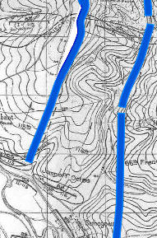
1st 115th INF
8 OCT
Intermediate Objective
3rd BN 116th INF
8 OCT
Brabant
1st 115th INF
66th French
Jump-off 8 OCT
3rd BN 116th INF
Samogneux

Slide 12
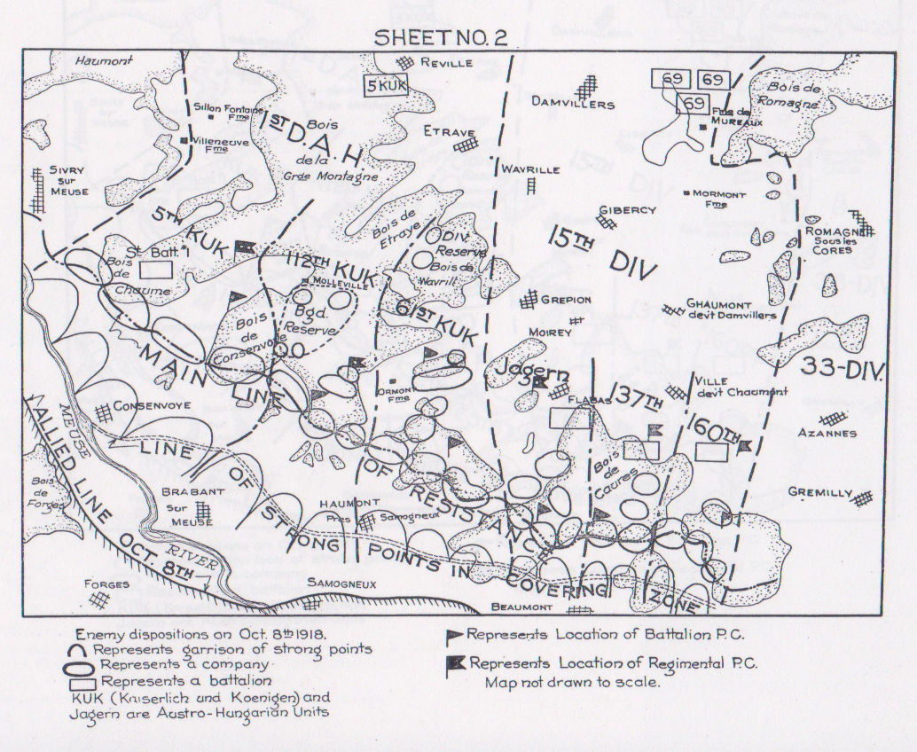
KuK 1st and 15th Division Positions 8 OCT 1918
Samogneux

Slide 13
US VANG 116th INF REGT, KuK 61st INF REGT and 112th INF REGT Actions on the Intermediate Objective
Thirty minutes into the assault the KuK artillery began firing onto the advancing 116th INF REGT
The 3/116 INF reached the KuK 112th INF REGT’s advanced trenches at 0620, 8 OCT 1918
These advanced positions were only lightly maned
The first line was well constructed. Many KuK troops waited in these bunkers for the first 3/116th wave to pass then came out fighting sometimes as the 1/116th (support) was advancing on them. Among them were KuK 112th INF machineguners. These troops did considerable damage to the 116th INF with captured UK Lewis guns. However, in one instance 3/116th INF REGT HQ troops killed three machineguners with their pistols and captured 14 prisoners
0700 the KuK 112th INF REGT’s second line was reached
KuK artillery rained down on the 116th REGT
1LT Fred Traut (MD officer assigned to I CO 116) is severely wounded by FA fire at this point. (First officer casualty of 116)
KuK 1st Division resistance was stiffest on their own main position, which was the 29th Division’s Intermediate Objective
This is along the northern slope of Malbrook Hill and the southern edge of the Bois Brabant-sur-Meuse
Part of the Intermediate Objective was reached by the 116th at 1630, 8 OCT 1918
The 3/116th INF REGT was checked by heavy machine gun fire 200 meters short of the objective
As follow on units moved up with 3/116th INF, the resulting concentration of fire overwhelmed the KuK 112th and the trenches on the objective fell to 116th bayonets

Slide 14
US VANG 116th INF REGT, KuK 61st INF REGT and 112th INF REGT Actions on the Intermediate Objective
The 116th INF cleared the KuK trench line on the Intermediate Objective but then came under heavy fire from their right flank. This fire was from the Bois d’Ormont and Ormont Farms
The entire regiment took casualties from this fire but the 3/116th INF especially so
MAJ Robert Conrad fell to this fire, leading I Company (awarded the Distinguished Service Cross)
LT Dinges (only surviving officer of I CO) assumed command of I Company and led an assault on the KuK positions to the right flank. These positions are taken, along with 19 prisoners, and four machine guns
Later in the day, Corporal Allamong (I CO) single-handed captured three machine guns and 26 prisoners (awarded the Distinguished Service Cross)
1LT Cunningham (LNO with 3/116th INF) saves a wounded soldier under heavy machinegun fire (awarded the Distinguished Service Cross) but is killed a few days later leading a platoon against an enemy machinegun nest
116th INF was under heavy fire from infantry direct fire, artillery, and close air support for two hours on the Intermediate Objective

Slide 15
US VANG 116th INF REGT, KuK 61st INF REGT and 112th INF REGT Actions on the Intermediate Objective
As the 116th INF occupied the Intermediate objective, heavy fire from dug in machinegun positions on the northern and eastern slopes of Malbrouck Hill on the left flank checked further advance
L Company lead by CPT Johnston, on his own initiative, launched a flank attack on the enemy positions on Malbrouck Hill.
L CO assault is followed up by a bayonet assault by K Company (LT Stone) (awarded the distinguished service cross)
Resistance on Malbrouck Hill is overcome and 210 prisoners taken, including a KuK BN commander, and his staff
At Bois de Brabant 116th INF captured 18 heavy machineguns, many Lewis guns, five cannon, two mortars, as well as an ammunition dump and food cache’
At 1300 the 1/116 passes through the 3/116 to become the attacking battalion
1/116th BN immediately hits heavy resistance from machines guns and rifle fire along the high ground of the Brabant Woods
1/116th BN moves slowly, after reducing the enemy machine guns, to the northern slope of the Normal Objective (Molleville Woods) reaching it at 1540
Soldiers from 3/116th BN: SGT Gorman, CPL Allen, CPL Maxie, PVT Techel, PVT Dunn (killed) attacked and captured eight enemy machine guns and their crews (all are awarded the Distinguished Service Cross)
At Bois de Consenvoye SGT Gregory (Headquarters CO, 116th INF) (from Chace City, VA) moved forward from his trench mortar section with a rifle and an improvised grenade
Captured a machine gun and its crew
Captured a 7,5cm Mountain Howitzer and its crew
Captured 19 additional enemy troops in a dug out
He is awarded the Congressional Medal of Honor

Slide 16
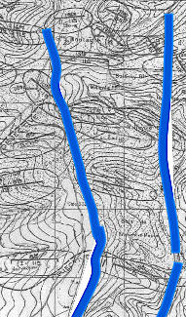
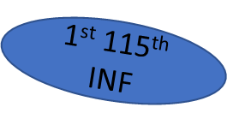
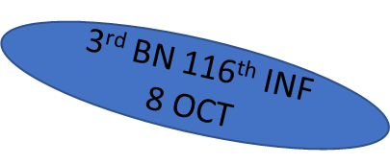
1st 116th INF
12 OCT
Normal Objective
1st 116th INF BN
8 OCT
1st 116th INF
10 ^{OCT}
2nd BN 116th INF
8 OCT
Intermediate Objective

Slide 17
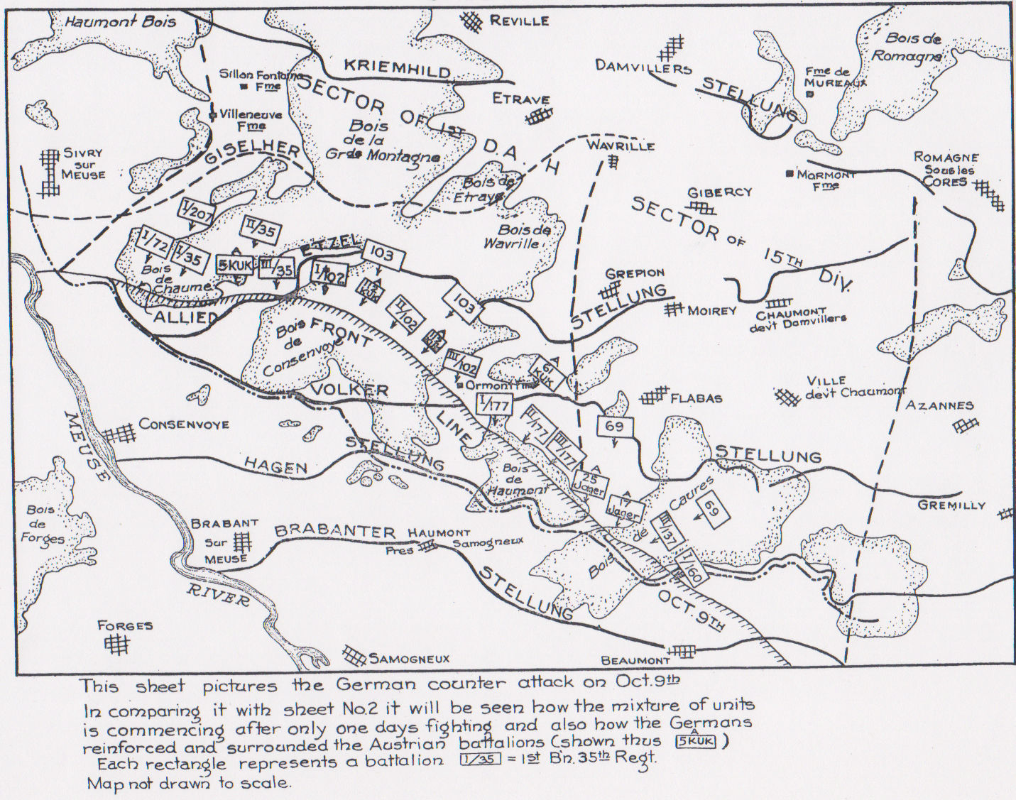
KuK 1st and 15th Divisions Counterattack 9 OCT 1918
Samogneux

Slide 18
On 9 OCT 1918, the 116th repulsed a weak enemy counterattack and then advanced another kilometer into the Molleville Woods until it ran into the last of the fortified belts, the Eitzel Stellung
It held in place there on the 10th while the rest of the division came up on line. The next day the 1st and 2d Battalions made three separate tries to cross the open ground of the Molleville Farm but were stopped cold by intense fire, and several days passed while the division caught its breath
After a brief artillery barrage the 3d Battalion resumed the offensive again under the cover of thick fog on 15 OCT
3/116th INF BN reduced to a third of the numbers who began the attack on the 8th, the battalion was able to push forward into the Grande Montagne Woods
During this drive MAJ Hierome Opie's command post took a direct hit. Although wounded, he refused to go to the rear until dark, awarded the (Distinguished Service Cross and French Croix de Guerre)
Col. John Palmer ordered the 58th Infantry Brigade to shift to skirmish line tactics to increase assault firepower. On the 16th, led by the 1st Battalion, the 116th reached its final objective (Hills 370 and 375) and went on the defensive at 7:30 in the evening

